Slide 1




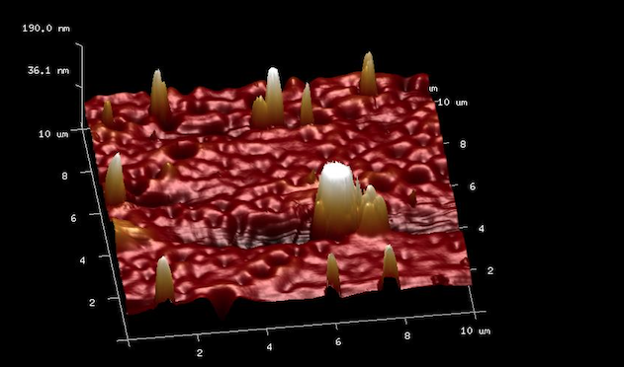

Industry Day Theme # {Insert Theme Name}
Boosting silicon solar cell efficiency through upconversion-assisted enhanced absorption in near infrared
Nidhi Dua, Rajinder Singh Deol, Md Samim Reza, Madhusudan Singh
Abstract
An upconversion based absorber (NaYF₄: Yb(18%), Er(2%), Gd(15%)) is developed to work at 980 nm used for increasing the sensitivity of a commercial solar cell. Tuning the precise loading ratio with these upconversion absorbers and developing films on top of solar cell is used to enhance short circuit currents.
Results
Figure 1: (a) Powder XRD of the upconversion absorber, (NaYF₄: Yb(18%), Er(2%), Gd(15%)). Red (blue) lines indicate hexagonal (cubic) phase of nanoparticles.
(b) Scanning electron microscopy (SEM) scans of the deposited reveal a thickness of ~158±33 nm.
(c) Atomic force microscopy (AFM) scans reveal that the roughness of the films is approximately 31 nm.
(d) Photoluminescence measurement of UCNP film under direct irradiance of 785 nm laser source.
(e) Current (A) versus voltage (V) curve for a commercial solar cell with UCNP film on top of it.
Introduction
Power conversion efficiencies in silicon are impacted by bulk defects, contacts, solar spectrum mismatch, etc. Specifically, the absorption coefficient in silicon starts declining below
10³ cm⁻¹ above around 800 nm, declining to one-tenth that value near 1000 nm. Such material limitations also manifest themselves in a peak in the responsivity of silicon-based solar cells [1]. Hence the upconversion technique employed here is a step toward overcoming these limitations. It is a process that takes two or more infrared photons and emit one visible photon. As a result, silicon solar cell which has highest efficiency in visible region indirectly detects infrared photons [2].
Materials and Methods
Process steps for material synthesis [3],
Film formation process,
(a)
(b)
(c)
(d)
Powder XRD reveals mostly of hexagonal phase closely associated with high upconversion photoluminescence efficiencies.
Under direct irradiance of 980 nm laser diode, we observed an enhancement of the short-circuit current (J_{sc}) of ~ 25%.
Blue signal is quenched when excited with 785 nm laser source.
Lanthanide Gd results in complete phase transfer from cubic to hexagonal [4].
Department of Electrical Engineering
(e)
Conclusions
Low temperature synthesis pathway for upconversion nanoparticles which is suitable under normal environmental conditions.
Optimizing the film thickness for the fixed dopant concentration is desired for maximum light generation from the sample for given excitation.
Synthesizing an efficient material with high quantum efficiency is still a challenge at present.
References
¹ Ramasamy et al., RSC Adv. 4, 34873 (2014).
² M Haase et al., Angewandte Chemie 50, 5808 (2011).
³ Z. Li et al., Nanotechnology 19, 345606 (2008).
⁴ F. Wang et al., Nature 463, 1061 (2010).
Acknowledgement
UGC, Government of India.
MEIT, Government of India.
Science & Engineering Research Board.
Nanoscale Research Facility at IIT Delhi.
Central Research Facility at IIT Delhi.
Optics Physics Lab at IIT-Delhi.
Industrial Significance
Idea of using upconversion nanolayers in solar cells utilizing IR spectrum will reduce its cost to 7$-8$ compared to 3000$ at present for InGaAs based products. Integrating solar cells/detectors with this layer will enhance their operating range thus making it a more industry oriented product suitable for applications such as remote sensing, surveillance, hyperspectral imaging etc.
Technology Readiness Level: Your content goes
here…

